Slide 1
Homework assignment - Offshore Leaks database analysis
Izolda Motiejauskytė

Slide 2
Exploratory analysis – part 1
Data leaks similarities:
Each data leak contains information about nodes :
Entity: node_id,name, jurisdiction ,jurisdiction_description, country_codes, countries, incorporation_date, inactivation_date, struck_off_date, closed_date, ibcRUC, status, company_type, service_provider, sourceID valid_until, note;
Officer: node_id, name, country_codes, countries, sourceID, valid_until ;
Intermediary: node_id, name, country_codes, countries, status, sourceID, valid_until, note;
Address: node_id, name address, country_codes, countries, sourceID, valid_until, note.
Each data leak contains information about edges: START_ID, TYPE, END_ID, link, start_date, end_date, sourceID, valid_until;
Dependant on data leak it might have more columns than mentioned before. It is listed most common columns.
Not all columns in data sets are populated, for example Panama papers contain information about intermediary status, but Offshore Leaks don’t.
Data leaks include entities which jurisdiction countries are low-tax areas.
Records are taken from seven corporate registries (Aruba, Cook Islands, Bahamas, Barbados, Malta, Nevis and Samoa) and the offshore law firm Appleby.

Slide 3
Exploratory analysis – part 1
Data leaks differences:
Paradise Papers include additional node called ‘Other‘ : node_id, name, country_codes, countries, sourceID, valid_until, note; This node “other” connects all the entities that are part of a holding group.
Each data leak has different data scope. For example Panama papers has longest list of entities. It contains different timeline as well. Bahamas Leak includes only entities were jurisdiction country is Bahamas. Overall Bahamas Leak includes only entities/intermederies/officers registered in Bahamas.

Slide 4
Exploratory analysis – part 1
Data quality:
There are missing values in columns;
Cities are entered instead of countries in country fields, for example Hong Kong.
There are typos in entity/intermediary/officer names, addresses.
Isolated entities or people with no apparent connections have been removed. Isolated addresses have also been removed.
Addresses don’t have assigned country to it.
Due to lacking of time all data issues are ignored in further analysis. If entity changed intermediary or officer, new row in entities file is added, however, it gets new node_ID, so in further calculations such entities are treated as separate entity and are included in counts.

Slide 5
Exploratory analysis – part 2 Automated data pypline
Country coverage and connections are covered by markdown report and code behind it. For investigations it is decided take only one of four data leaks – Panama papers. Report is based on populated columns in Panama papers data and changing source might issue errors. Due to lack of time it is decided to don’t to adaptation. Comments about graphs are provided in slides if further development would be taken.
If you want to run the report (and download data), you have to use code in cmd:
“C:\Program Files\R\R-3.6.1\bin\R” -e "rmarkdown::render('exploratory_analysis.Rmd',output_file=‘exploratory_analysis.html')“. HTML report will be rendered.
Report generation might take a couple of minutes. Rendering might not be working if you haven’t installed all necessary packages. If you get error, go to R code and install necessary packages used.
Example of HTML report and markdown code is attached. Code contains comments to be able to understand what written code does.

Slide 6
Exploratory analysis – part 2
As mentioned Markdown provides graphs based on any of four data leaks. Given comments bellow are based on Panama papers data leak.
Most common countries where offshore companies are registered are Hong Kong (China) and Switzerland. A big part of offshore entities are based in Europe. Second biggest part – Asia. Most attractive jurisdiction countries for entities are British Virgin Islands and Panama. They are not attractive only for biggest entities countries.
Offshore entities establishment started at 1980, but reached highest peak around 2000. Around 50% of them are now defaulted or having difficulties.
Most common intermediary countries are Hong Kong, United Kingdom and Switzerland. We might assume that most of the entities are looking for intermediaries based in registration country.
Most popular Officer countries are China and Virgin Islands. A lot of Officers don’t have assigned country.

Slide 7
Exploratory analysis – part 2
As expected, most of entities and officers addresses can be found in China. A lot of addresses don’t have assigned country to it.
It is more common for officers to have entities in foreign countries. Only exclusion is Hong Kong city, where most of officers living there have entities registered in the same city. Similar way is for officers from Jersey.
‘Frequency graph about intermediary working with entities in domestic/foreign countries’ graph indicates that intermediary companies tend to help establish new entity in their country. Same tendency can be recognized from the heatmap, where darkest parts are on diagonal.
Even though overall there is trend to have entity and intermediary in the same country, biggest countries by entity number established in are working with intermediaries from more than 10 different countries.
Mentioned insights are based on provided graphs. Due to lack of time it was decided to reduce number of graphs. Further analysis could be made.

Slide 8
Exploratory analysis – part 3
Analysis about Swedbank home markets are based on same Panama papers data leak and graphs are included in Markdown report.
Only a smart part of offshore companies are registered in Baltics and Sweden. It’s only around 1% of reported entities in Panama papers. Most of them are in Latvia.
Biggest part entities jurisdiction country is British Virgin Islands.
First offshore companies were established much later comparing with the overall picture and peak was reached approximately 10 years later.
More than 50% of entities are defaulted now.
Sweden has biggest part of intermediary companies established in Swedbank home markets, Lithuania has the smallest and all intermediaries are suspended there.

Slide 9
Exploratory analysis – part 3
Most of the Officers are living/registered in Sweden and accordingly biggest part of addresses can be found there.
It is hard to measure exposure of Swedbank home markets since we don’t have information about cash flows. Even though only 1% of investigated entities are registered in Baltic countries and Sweden, it’s a big percentage for such small Baltic countries. Huge impact has that Russia is in top 5 list of countries having highest offshore companies in world according to Panama papers data. Since Russia tends to use Baltic countries for cash flows it’s having higher impact for Swedbank home markets.

Slide 10
Modelling different node types
Unfortunately, subtask was not fully clear. Since we don’t know any classes nodes belong to and we could only guess, clusterization approach should be taken instead of classification . Panama papers data sets were taken in such investigations.
I tried to analyze given data in two ways –
Clustering nodes considering data as network (graph);
Taking entity nodes as group to be clustered and joining other nodes information as features of entity nodes. Unfortunately, since not all entity nodes had officer/intermediary/address, it caused quite much NA values. Missing values were replaced by blank spaces, since deleting empty rows would cause having only 20% of the data.

Slide 11
Modelling different node types
Regarding taken Panama papers data set, graph was created. Unfortunately, since it has approximately ½ million nodes, due lack of computer resources it was not possible to make any further calculation (including taking subgraphs). Given code in file is just a guide line and one example how it’s possible to clusterize graph nodes. More short examples can be found –
https://kateto.net/netscix2016.html.
#creating graph
g <- graph_from_data_frame(d=graph_edges_list, vertices=graph_nodes_cleaned, directed=FALSE)
#calculating main graph characteristics
#average distance
mean_distance(g, directed=F)
#largest subgraphs
largest_cliques(g)
#betweeness
betweenness(net, directed=T, weights=NA)
#############################################################
#Clusters detection based on edge betweenness (Newman-Girvan)
ceb <- cluster_edge_betweenness(g)
#number of clusters
length(ceb)
#each node and it's cluster
membership(ceb)
#############################################################

Slide 12
Modelling different node types
Considering second approach, entity nodes were taken as a base and information about officers/intermediaries and addresses were added by merging tables based on given edges. Officer/intermediaries information was taken as features as well (same join principles).
Since all information about entities are categorical, there are only few algorithms that can be used for clusterization exercise: Kmode, ROCK, Hierarchical clustering (using Gower distance).
Unfortunately, due lacking computer memory it was not possible to calculate Gower dissimilarity matrix. ROCK algorithm wasn’t working due to NA values. So, only Kmode algorithm was applied.

Slide 13
Modelling entity nodes
The K-modes algorithm extends K-means paradigm to cluster categorical data. It uses modes instead of means for clusters. Since K-modes algorithm uses the same clustering principles as K-means, it preserves the efficiency of the K-means algorithm. More information can be found here - https://arxiv.org/ftp/cs/papers/0603/0603120.pdf.
Before we start to use algorithm, we should define number of possible clusters in data. Typically, silhouette analysis, Calinski-Harabasz criterion and etc. is used to determine number of clusters. Due to lack of time it was decided to skip this analysis and make an example model just to test if algorithm is working at all.
Modeling code can be found in provided R code.

Slide 14
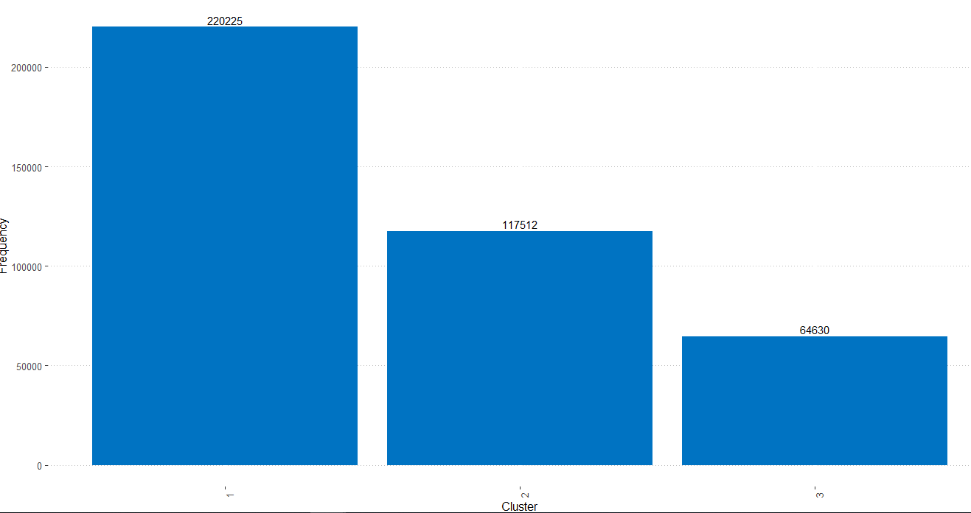
Modelling entity nodes
As an example, we assumed that nodes should be splited into three clusters. By graph given below you can see that most of the nodes were selected to first cluster.

Slide 15
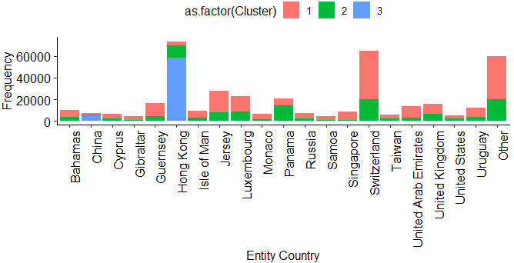
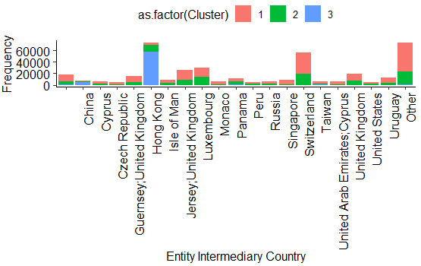
Modelling entity nodes

Slide 16
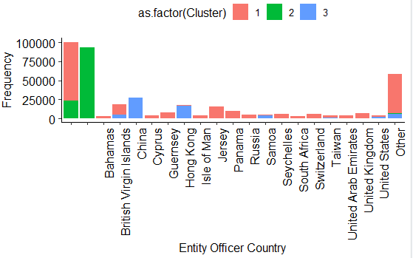
Modelling entity nodes
By three given graphs we can see that typically entities from Cluster 3 are placed in China and taking Intermediary from domestic countries. Entities that don’t have officer information belong to Cluster two. We can assume that our algorithm is partly working. Unfortunately, there is still huge spread between 1 and 2 clusters considering entity country and intermediary country. It would be worth to consider bigger number of clusters.

Slide 17
Modelling different node types
Things to consider for next time analysis:
Consider reduce number of nodes in graph (sampling it) and try to investigate more clusterization algorithms for networks/graphs.
Try to find more effective way to fill in data gaps or consider taking out nodes types that have significantly lower match values with nodes we are trying to cluster.
Have deeper algorithm analysis for data sets that have only categorical variables.

